Slide 1
Variant Calling

Slide 2
Learning Objectives
To learn about the general workflow of variant calling
To understand the different filters and quality control features of variant calling

Slide 3
Next Generation Sequencing (NGS)
The high-throughput sequencing of whole genomes has quickly become a common practice in the research community
A typical experiment can produce 100s of millions of sequence reads per lane, with over 10 billion nucleotides sequenced
multiplied further by the number of individual experiments/samples!
This vast amount of data requires a particular set of computational tools to analyze and interpret

Slide 4
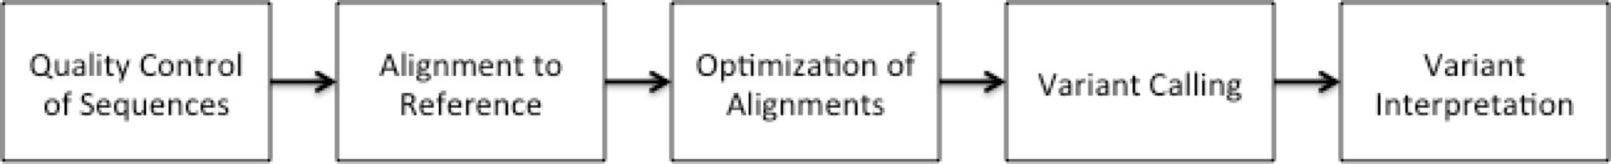
Generic Workflow for NGS
There are many different ways to analyze sequences generated from NGS, depending on the specific question you are investigating
For the analysis of genomic sequence data, a typical (if generic) approach is as follows

Slide 5
Quality Control (QC)
Quality checks of raw sequence data are very important
Common problems can include:
Sample mix-up
Sample contamination
Machine interruption
DNA quality
It is crucial that investigators examine their sequences upon first receipt before any downstream analysis is conducted

Slide 6
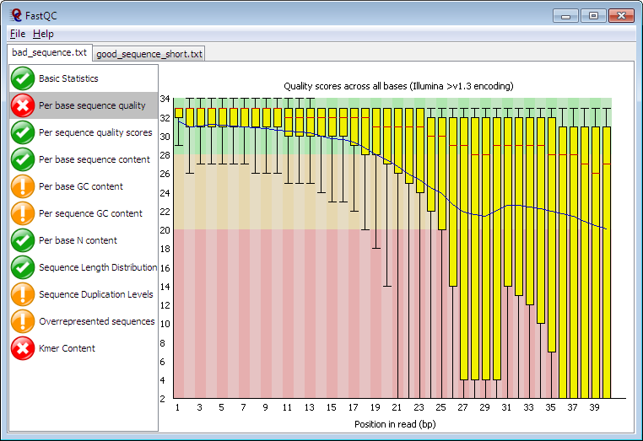
FASTQC
FASTQC is one approach which provides a visual interpretation of the raw sequence reads
http://www.bioinformatics.babraham.ac.uk/projects/fastqc/

Slide 7
Sequence Alignment
Once sequence quality has been assessed, the next step is to align the sequence to a reference genome
There are many distinct tools for doing this; which one you choose is often a reflection of your specific experiment and personal preference
BWA Bowtie SOAP2 Novoalign mr/mrsFast Eland Blat Bfast | BarraCUDA CASHx GSNAP Mosiak Stampy SHRiMP SeqMap SLIDER | RMAP SSAHA etc

Slide 8
Sequence Alignment
Once sequence quality has been assessed, the next step is to align the sequence to a reference genome
There are many distinct tools for doing this; which one you choose is often a reflection of your specific experiment and personal preference
BWA Bowtie SOAP2 Novoalign mr/mrsFast Eland Blat Bfast | BarraCUDA CASHx GSNAP Mosiak Stampy SHRiMP SeqMap SLIDER | RMAP SSAHA etc
Note: Many of these use the Burrows-Wheeler Transform we worked on previously!

Slide 9
SAM Format
Sequence Alignment/Map (SAM) format is the almost-universal sequence alignment format for NGS
binary version is BAM
It consists of a header section (lines start with ‘@’) and an alignment section
The official specification can be found here:
http://samtools.sourceforge.net/SAM1.pdf

Slide 10
Example SAM File
Header section
@HD VN:1.0 SO:coordinate
@SQ SN:1 LN:249250621 AS:NCBI37 UR:file:/data/local/ref/GATK/human_g1k_v37.fasta M5:1b22b98cdeb4a9304cb5d48026a85128
@SQ SN:2 LN:243199373 AS:NCBI37 UR:file:/data/local/ref/GATK/human_g1k_v37.fasta M5:a0d9851da00400dec1098a9255ac712e
@SQ SN:3 LN:198022430 AS:NCBI37 UR:file:/data/local/ref/GATK/human_g1k_v37.fasta M5:fdfd811849cc2fadebc929bb925902e5
@RG ID:UM0098:1 PL:ILLUMINA PU:HWUSI-EAS1707-615LHAAXX-L001 LB:80 DT:2010-05-05T20:00:00-0400 SM:SD37743 CN:UMCORE
@RG ID:UM0098:2 PL:ILLUMINA PU:HWUSI-EAS1707-615LHAAXX-L002 LB:80 DT:2010-05-05T20:00:00-0400 SM:SD37743 CN:UMCORE
@PG ID:bwa VN:0.5.4
Alignment section
1:497:R:-272+13M17D24M 113 1 497 37 37M 15 100338662 0 CGGGTCTGACCTGAGGAGAACTGTGCTCCGCCTTCAG 0;==-==9;>>>>>=>>>>>>>>>>>=>>>>>>>>>> XT:A:U NM:i:0 SM:i:37 AM:i:0 X0:i:1 X1:i:0 XM:i:0 XO:i:0 XG:i:0 MD:Z:37
19:20389:F:275+18M2D19M 99 1 17644 0 37M = 17919 314 TATGACTGCTAATAATACCTACACATGTTAGAACCAT >>>>>>>>>>>>>>>>>>>><<>>><<>>4::>>:<9 RG:Z:UM0098:1 XT:A:R NM:i:0 SM:i:0 AM:i:0 X0:i:4 X1:i:0 XM:i:0 XO:i:0 XG:i:0 MD:Z:37
19:20389:F:275+18M2D19M 147 1 17919 0 18M2D19M = 17644 -314 GTAGTACCAACTGTAAGTCCTTATCTTCATACTTTGT ;44999;499<8<8<<<8<<><<<<><7<;<<<>><< XT:A:R NM:i:2 SM:i:0 AM:i:0 X0:i:4 X1:i:0 XM:i:0 XO:i:1 XG:i:2 MD:Z:18^CA19
9:21597+10M2I25M:R:-209 83 1 21678 0 8M2I27M = 21469 -244 CACCACATCACATATACCAAGCCTGGCTGTGTCTTCT <;9<<5><<<<><<<>><<><>><9>><>>>9>>><> XT:A:R NM:i:2 SM:i:0 AM:i:0 X0:i:5 X1:i:0 XM:i:0 XO:i:1 XG:i:2 MD:Z:35
http://genome.sph.umich.edu/wiki/SAM

Slide 11
SAM Utilities
Samtools is a common toolkit for analyzing and manipulating files in SAM/BAM format
http://samtools.sourceforge.net/
Picard is a another set of utilities that can used to manipulate and modify SAM files
http://picard.sourceforge.net/
These can be used for viewing, parsing, sorting, and filtering SAM files as well as adding new information (e.g. Read Groups)

Slide 12
SAM Utilities for Python
pysam - An interface for reading and writing SAM files
https://pysam.readthedocs.io/en/latest/api.html
bamnostic – a pure Python multi-version tolerant, runtime and OS-agnostic Binary Alignment Map (BAM) file parser and random access tool
https://bamnostic.readthedocs.io/en/latest/
(created by Marcus Sherman, DCM&B Doctoral Student!)

Slide 13
Post-alignment Optimization
A lot of research has been conducted to improve and optimize sequence alignments
However, genomic sequences are very complex and by their very nature can preclude the ability to accurately determine where a sequence read originated
New tools and approaches have been developed to help address these shortcomings and improve our overall ability to interpret the alignments

Slide 14
Genome Analysis Toolkit (GATK)
Developed in part to aid in the analysis of 1000 Genomes Project data
Includes many tools for manipulating, filtering, and utilizing next generation sequence data
http://www.broadinstitute.org/gatk/

Slide 15
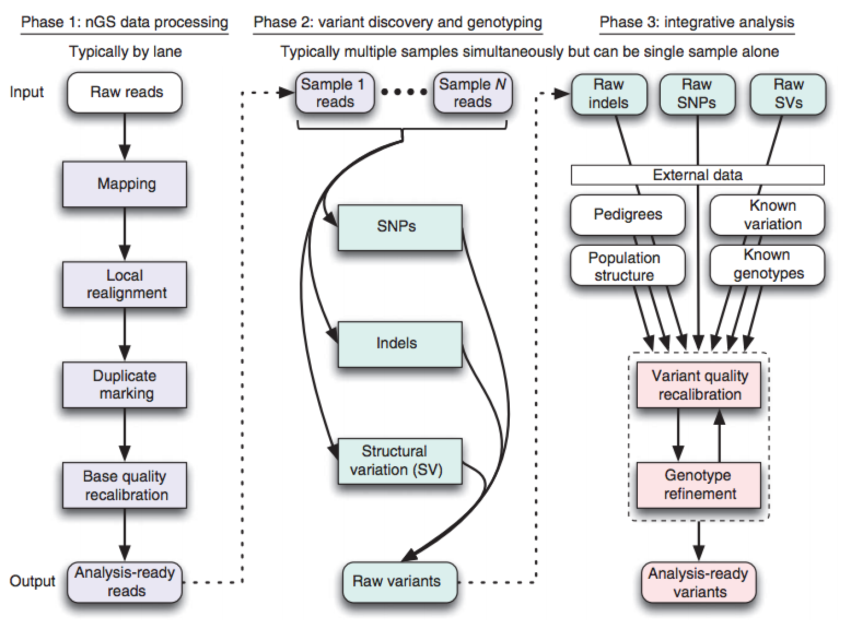
GATK Workflow
DePristo MA et al. (2011) Nat. Genet. 43, pp. 491-498

Slide 16
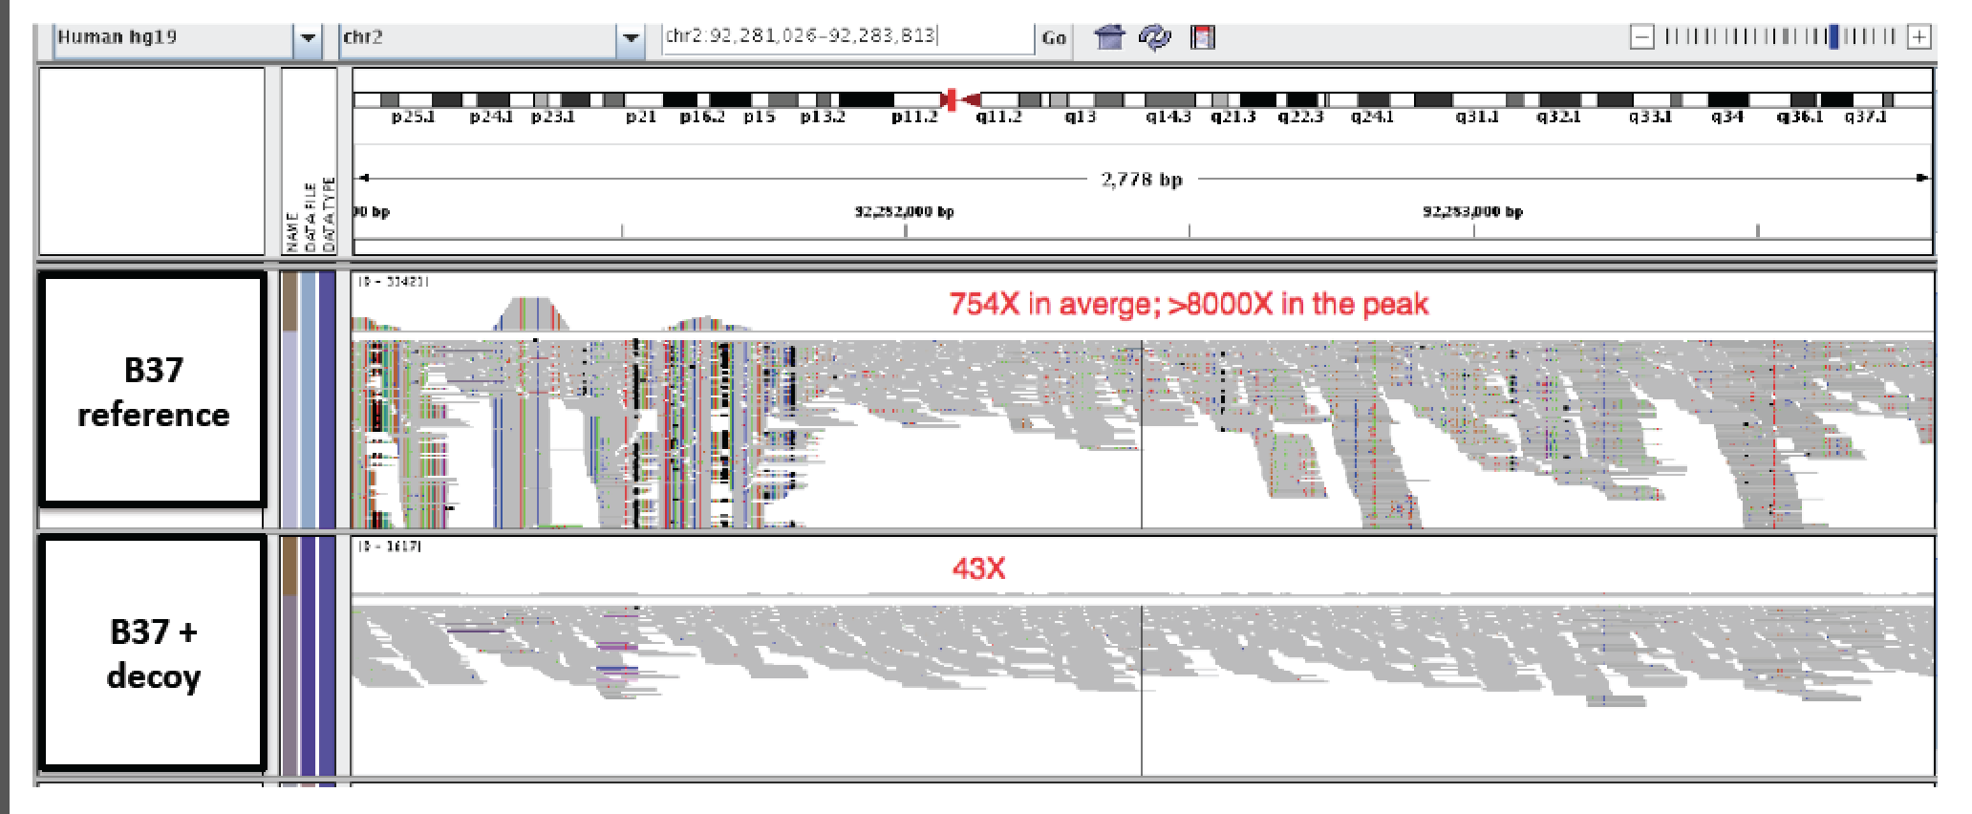
Decoy Mapping
One approach is to allow reads to map to a “decoy” alignment of extra-chromosomal or unassembled sequences
from Heng Li

Slide 17
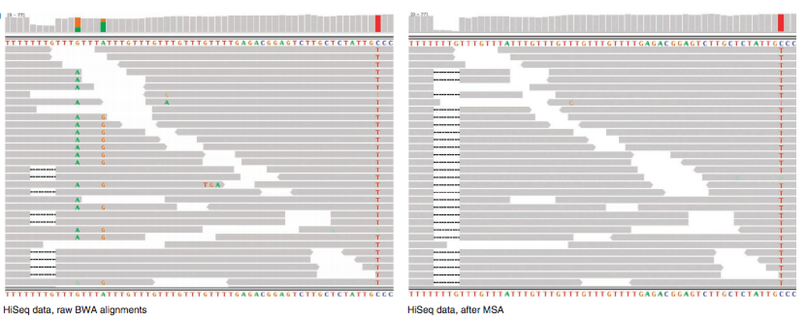
Realignment around INDELs
Insertions and deletions in samples can cause misalignments, resulting in false variant detection
By identifying regions with known INDELs or reads which may have INDEL characteristics and performing multiple sequence alignments, these alignments can be rescued
DePristo MA et al. (2011) Nat. Genet. 43, pp. 491-498

Slide 18
Marking/Removing Duplicate Sequences
Sequence biases can arise from PCR amplification effects during the construction of the library
There can also be optical duplicates which occur when sequences from one cluster are accidentally identified as arising as well from adjacent clusters
Both Picard (MarkDuplicates) and Samtools (rmdup) have utilities for addressing one or both of these issues

Slide 19
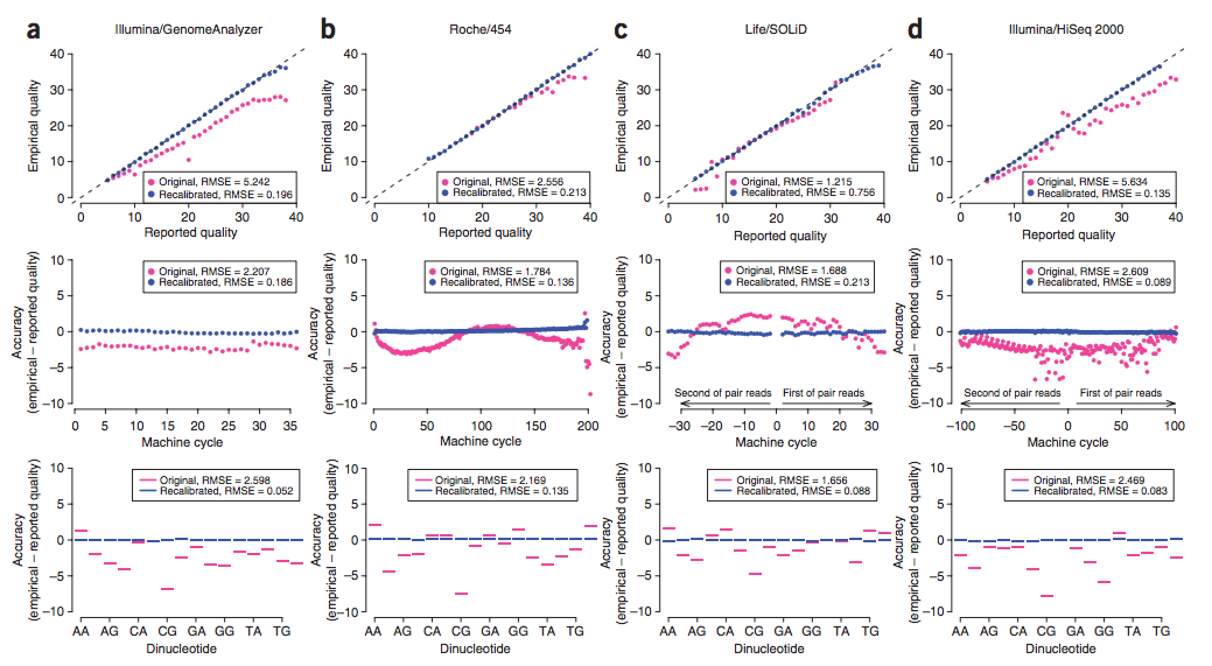
Base Recalibration
Provides empirically accurate base quality scores for each base in every read
Also corrects for error covariates like machine cycle and dinucleotide content
DePristo MA et al. (2011) Nat. Genet. 43, pp. 491-498

Slide 20
Variant Calling
Once an alignment file of satisfactory accuracy has been constructed, the next step is usually to identify genetic variants
This can be done in two different ways
Internally: Identification of heterozygous regions within the sample
Externally: Identification of homozygous or heterozygous regions compared to a reference or population data set

Slide 21
SNP/INDEL Calling Software
As with alignment approaches, there are many different variant calling methods.
As GATK and Samtools are almost ubiquitously used for genomic analysis, there internal tools are often used for this purpose:
Samtools: mpileup
GATK: UnifiedGenotyper
However, as with most analysis there are often other tools which may be more appropriate for your experiments

Slide 22
Identifying Variation from WGS
SNPs
ATCCTGATTCGGTGAACGTTATCGACGATCCGATCGA
ATCCTGATTCGGTGAACGTTATCGACGATCCGATCGA
CGGTGAACGTTATCGACGATCCGATCGAACTGTCAGC
GGTGAACGTTATCGACGTTCCGATCGAACTGTCAGCG
TGAACGTTATCGACGTTCCGATCGAACTGTCAGCGGC
TGAACGTTATCGACGTTCCGATCGAACTGTCAGCGGC
TGAACGTTATCGACGTTCCGATCGAACTGTCAGCGGC
GTTATCGACGATCCGATCGAACTGTCAGCGGCAAGCT
TTATCGACGATCCGATCGAACTGTCAGCGGCAAGCT
ATCCTGATTCGGTGAACGTTATCGACGATCCGATCGAACTGTCAGCGGCAAGCTGATCGATCGATCGATGCTAGTG
reference genome
TTATCGACGATCCGATCGAACTGTCAGCGGCAAGCT
TCGACGATCCGATCGAACTGTCAGCGGCAAGCTGAT
ATCCGATCGAACTGTCAGCGGCAAGCTGATCG CGAT
TCCGATCGAACTGTCAGCGGCAAGCTGATCG CGATC
TCCGATCGAACTGTCAGCGGCAAGCTGATCGATCGA
GATCGAACTGTCAGCGGCAAGCTGATCG CGATCGA
AACTGTCAGCGGCAAGCTGATCG CGATCGATGCTA
TGTCAGCGGCAAGCTGATCGATCGATCGATGCTAG
TCAGCGGCAAGCTGATCGATCGATCGATGCTAGTG
INDELs

Slide 23

Identifying Variation from WGS
SNPs
ATCCTGATTCGGTGAACGTTATCGACGATCCGATCGA
ATCCTGATTCGGTGAACGTTATCGACGATCCGATCGA
CGGTGAACGTTATCGACGATCCGATCGAACTGTCAGC
GGTGAACGTTATCGACGTTCCGATCGAACTGTCAGCG
TGAACGTTATCGACGTTCCGATCGAACTGTCAGCGGC
TGAACGTTATCGACGTTCCGATCGAACTGTCAGCGGC
TGAACGTTATCGACGTTCCGATCGAACTGTCAGCGGC
GTTATCGACGATCCGATCGAACTGTCAGCGGCAAGCT
TTATCGACGATCCGATCGAACTGTCAGCGGCAAGCT
ATCCTGATTCGGTGAACGTTATCGACGATCCGATCGAACTGTCAGCGGCAAGCTGATCGATCGATCGATGCTAGTG
reference genome
TTATCGACGATCCGATCGAACTGTCAGCGGCAAGCT
TCGACGATCCGATCGAACTGTCAGCGGCAAGCTGAT
ATCCGATCGAACTGTCAGCGGCAAGCTGATCG CGAT
TCCGATCGAACTGTCAGCGGCAAGCTGATCG CGATC
We can use a simple binomial test to determine whether the observed bases are different (e.g. a real variant) or just noise.
A binomial test asserts the significance of deviations from a distribution of observations in 2 categories. That is, the probability of getting k successes in n trials
TCCGATCGAACTGTCAGCGGCAAGCTGATCGATCGA
GATCGAACTGTCAGCGGCAAGCTGATCG CGATCGA
AACTGTCAGCGGCAAGCTGATCG CGATCGATGCTA
TGTCAGCGGCAAGCTGATCGATCGATCGATGCTAG
TCAGCGGCAAGCTGATCGATCGATCGATGCTAGTG
INDELs
$$P\left(X=k\right)=\left(\frac{n}{k}\right)p^{k}{\left(1−p\right)}^{n−i}$$

Slide 24

Identifying Variation from WGS
In this example, we observe 8 As and 4 T’s. We wish to see if this is a heterozygous event; that is, there is an ‘A’ on one haplotype and a ‘T’ on the other. Thus, we expect there to be a .50 probability of one allele.
In this case, k=8, n=12, and p = 0.50. Using the equation below, we can derive a p-value that indicates whether our observations are significant different from 0.50.
This gives us 0.39, which (depending on the threshold set, often 0.05) fails to detect a difference, indicating that this is indeed heterozygous position. This is a two-tailed test here, so it indicates the chance of observation 8 or more A’s, or 4 or less T’s, given a probability of 0.5
ATCCTGATTCGGTGAACGTTATCGACGATCCGATCGA
ATCCTGATTCGGTGAACGTTATCGACGATCCGATCGA
CGGTGAACGTTATCGACGATCCGATCGAACTGTCAGC
GGTGAACGTTATCGACGTTCCGATCGAACTGTCAGCG
TGAACGTTATCGACGTTCCGATCGAACTGTCAGCGGC
TGAACGTTATCGACGTTCCGATCGAACTGTCAGCGGC
TGAACGTTATCGACGTTCCGATCGAACTGTCAGCGGC
GTTATCGACGATCCGATCGAACTGTCAGCGGCAAGCT
TTATCGACGATCCGATCGAACTGTCAGCGGCAAGCT
$$P\left(X=k\right)=\left(\frac{n}{k}\right)p^{k}{\left(1−p\right)}^{n−k}$$
ATCCTGATTCGGTGAACGTTATCGACGATCCGATCGAACTGTCAGCGGCAAGCTGATCG
reference genome
TTATCGACGATCCGATCGAACTGTCAGCGGCAAGCT
TCGACGATCCGATCGAACTGTCAGCGGCAAGCTGAT
ATCCGATCGAACTGTCAGCGGCAAGCTGATCG
Note: this is a simplistic example. Actual variant callers use additional information (e.g. LD to neighboring variation, platform specific error rates, etc)

Slide 25
Variant calling on structural variation
Read Pair Mapping
Read Depth Analysis
fragmentation
sequencing
sample genome
deletion
expected
> expected
reference genome
exact breakpoints
sample genome
deletion
exact breakpoints
fragmentation
sequencing
Split Read Alignment
Sequence Assembly

Slide 26
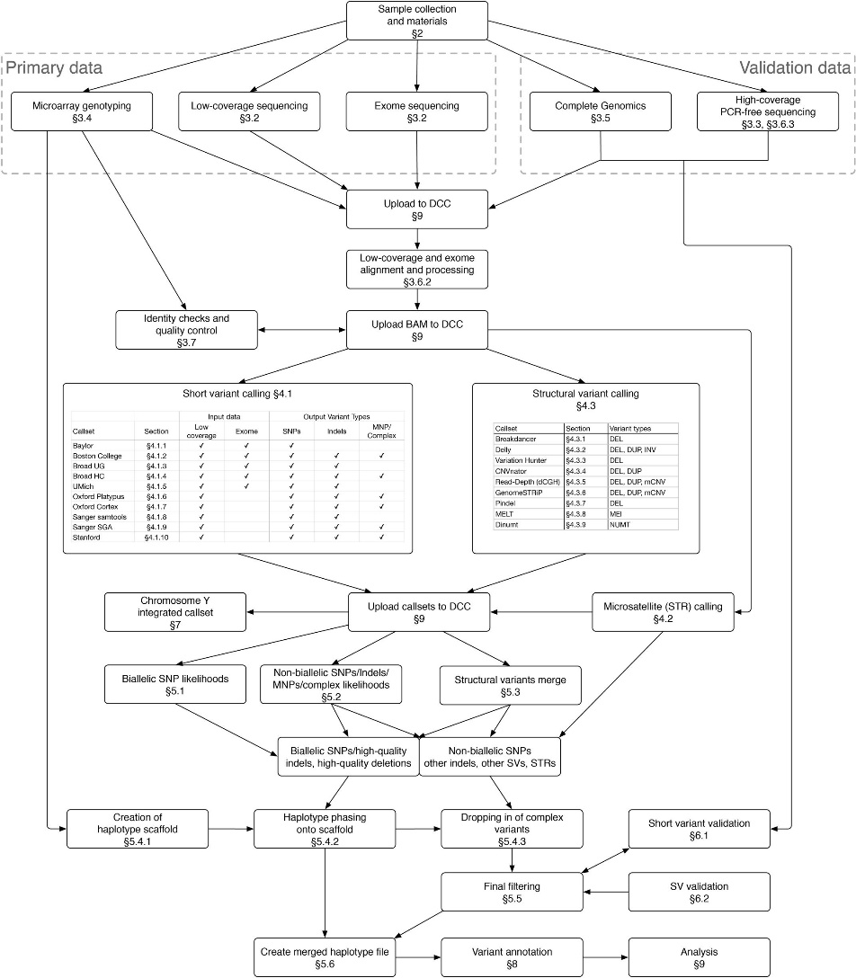
Large-scale variant calling
Auton, A., Abecasis, G., Altshuler, D. et al. A global reference for human genetic variation. Nature 526, 68–74 (2015). https://doi.org/10.1038/nature15393

